Slide 1


Practicum Presentation:1st Defense Topic: Detection of Plant Disease through CNN
Shivam Shukla, 09417711922 AI-DS(B)
Neeraj Rathore, 07217711922 AI-DS(B)
Samarth Hemrajani, 01617711922 AI-DS(A)
Piyush Bhardwaj, 04317711922 AI-DS(B)
Supervisor: Dr. Deepika Bhatia

Slide 2
Index of Contents
Introduction & Motivation
Problem Statement
Background Study
Technology Stack
Budget for the prototype (in case of hardware project)
Project Progress/Implementation(screenshots/video etc.)
Aim for the coming weeks
References

Slide 3
1) Introduction & Motivation
In order to ensure food security in the face of increasing population expansion, agribusiness—a crucial source of nutrition for the entire world—needs to raise production by 50–60%.
In the past ten years, production has increased by about 1% to 2% in India, despite a 20% increase in cultivation. Worldwide pests pose a danger to quality, particularly in Himachal Pradesh, India.
Highly contagious biotic illnesses that pose a risk to fruits and leaves. The research is the first to use a lightweight CNN model for quick illness diagnosis. leveraging AI and image processing to protect food security and help farmers.
The project will change disease diagnosis, provide farmers with a fast and precise tool, increase yields, and meet the world's food needs.

Slide 4
1) Introduction & Motivation
This project's main objective is to create a sophisticated system that uses deep learning models to recognize black rot, cedar rust, and scab on leaves.
This would ensure early identification of the diseases for efficient intervention and increased crop yield.
To implement algorithms to increase the precision and reliability of disease detection and categorization, specifically targeting issues affecting .
Give farmers a reliable tool for identifying diseases so they can make educated decisions to safeguard crops and increase total agricultural output.

Slide 5
2)Problem Statement
For crop health in contemporary agriculture, early disease identification is essential.
Farmers' lack of experience and limited access to resources make conventional approaches for identifying plant diseases through physical inspection labor-intensive and prone to error.
Convolutional Neural Networks (CNNs) are needed in an automated system to scan leaf photos and identify illnesses like powdery mildew and scab in order to overcome these difficulties.
This initiative promises to revolutionize disease management by enabling farmers to maximize resources and decrease losses by utilizing CNNs' image recognition capabilities.
Nevertheless, obtaining a varied dataset and refining the CNN model present obstacles.
All things considered, effective implementation might greatly increase cultivation's resilience and support global food security.

Slide 6
3)Background Study
We have carefully evaluated every project cost, including for hardware, software, design, and operational costs, with a particular emphasis on affordability for individuals and small-scale farmers worldwide.
The project's overall cost has been established to be both affordable and feasible, guaranteeing that individuals with restricted means can partake and gain from it.
The project shows that it is feasible in a variety of organizational settings, guaranteeing future users that it is applicable and efficient.
We've created a system that cuts across organizational boundaries and offers flexibility and scalability to meet changing demands and requirements through careful planning and planned implementation.
Obtaining the required permits for the usage of device cameras and leaf capture photographs is crucial because our project may make use of them.

Slide 7
3) Background Study
• Obtaining the required permits for the usage of device cameras and leaf capture photographs is crucial because our project may make use of them.
It is crucial to respect people's privacy and follow the law when it comes to taking pictures and using data.
Explicit consent from pertinent stakeholders is obtained in order to guarantee ethical behavior and openness during the project's execution.
This strategy not only promotes accountability and confidence, but it also helps to allay any ethical and legal worries about using data without authorization.
We thereby respect individual rights and responsible data management principles by giving permission-based access to project resources priority.
The model is being trained using a lidar dataset obtained from Kaggle.Our group has been working hard to set dates and deadlines for the project that is being suggested.

Slide 8
4)Technology Stack
• We made sure that all required resources were ready to use inside the project by carefully evaluating the hardware and software requirements that are critical for data collecting, preprocessing, and analysis.
We carefully examined a variety of machine learning methods, such as CNN and Xception, in addition to statistical techniques designed with anomaly identification in mind. • We've maintained data protection laws that regulate the collection and use of agricultural data while placing a high priority on protecting farmers' privacy.
The source of the data is Kaggle.

Slide 9
6)Project Progress/Implementation
The implementation phase of the project entailed the development and refinement of a sophisticated convolutional neural network (CNN) algorithm meticulously engineered for the precise detection of plant diseases.
- Development Process:
- Extensive development and refinement of a sophisticated convolutional neural network (CNN) algorithm tailored for precise plant disease detection.
- Methodical approach adopted for model training and optimization to ensure optimal performance.
- Accuracy Achievement:
- Attainment of an exemplary accuracy rate consistently ranging between 90-95% through rigorous training and validation procedures.
- Robust performance indicative of the model's efficacy in discerning subtle visual cues associated with plant ailments.
- **Dataset Diversity**:
- Utilization of a diverse dataset comprising 38 distinct classes of plant diseases to ensure comprehensive coverage across various botanical species and pathological conditions.
- Comprehensive dataset facilitates robust model generalization and enhances real-world applicability.
- **Technological Advancements**:
- Leveraging cutting-edge advancements in deep learning methodologies to develop a highly precise and reliable disease detection model.
- Significance of technological innovations in revolutionizing disease management strategies and optimizing agricultural practices.
- **Impact and Potential**:
- Significance of successful model deployment in advancing precision agriculture practices and enhancing global food security efforts.
- Potential for widespread adoption to revolutionize disease management strategies, optimize resource allocation, and increase agricultural productivity.

Slide 10
6)Project Progress/Implementation
- Dataset Diversity:
- Utilization of a diverse dataset comprising 38 distinct classes of plant diseases to ensure comprehensive coverage across various botanical species and pathological conditions.
- Comprehensive dataset facilitates robust model generalization and enhances real-world applicability.

Slide 11
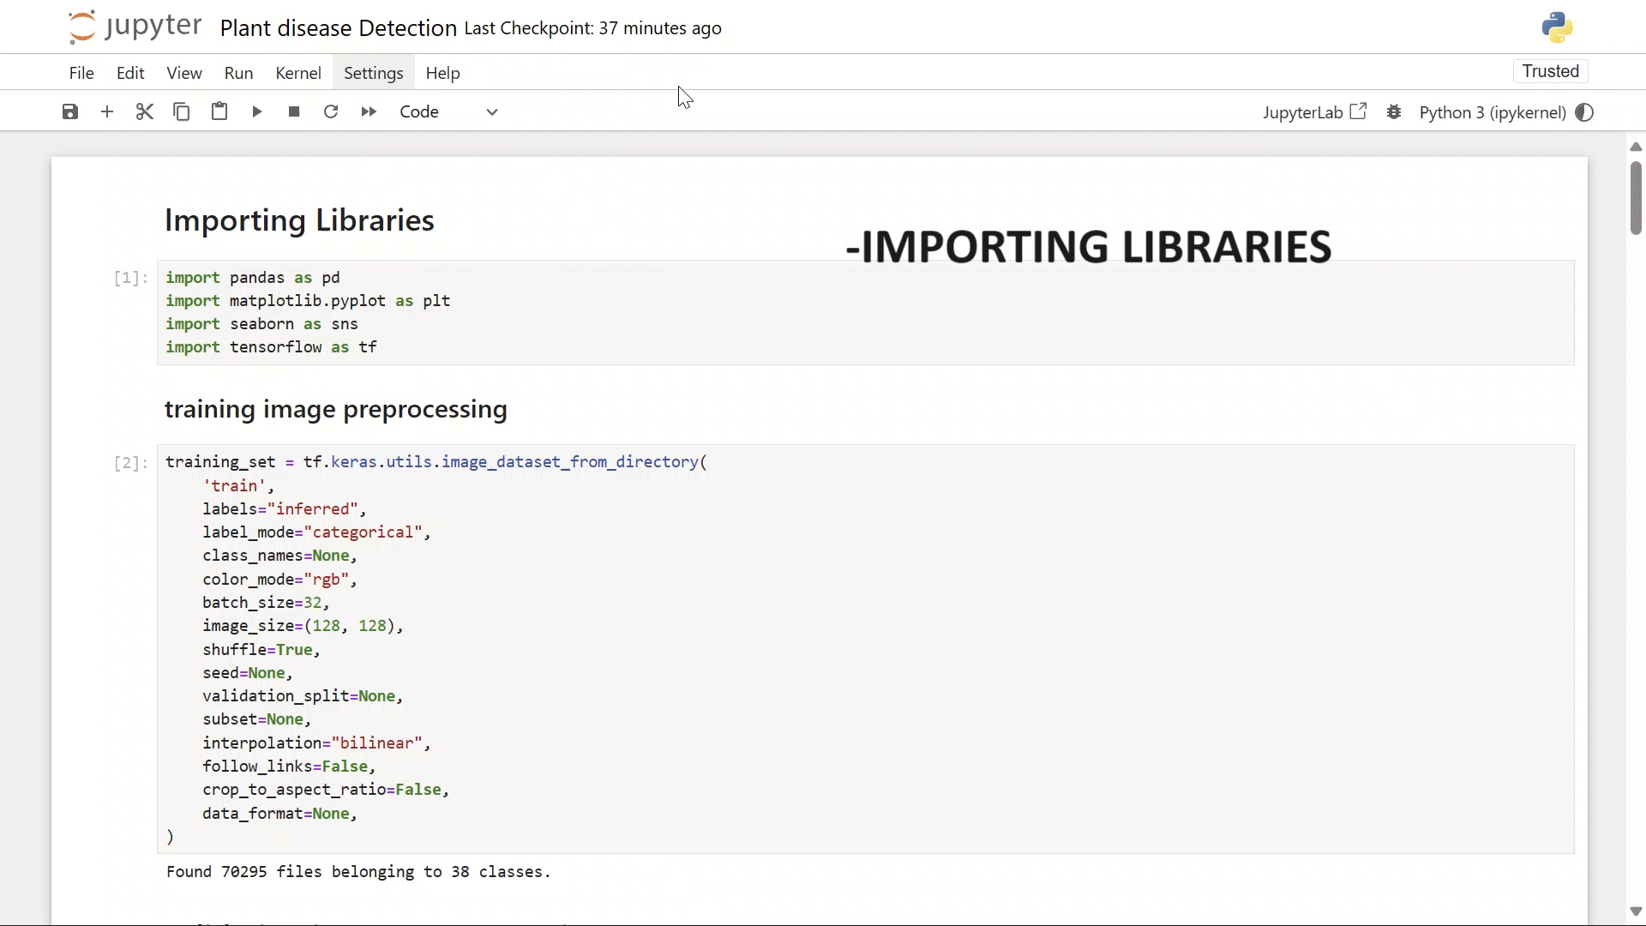
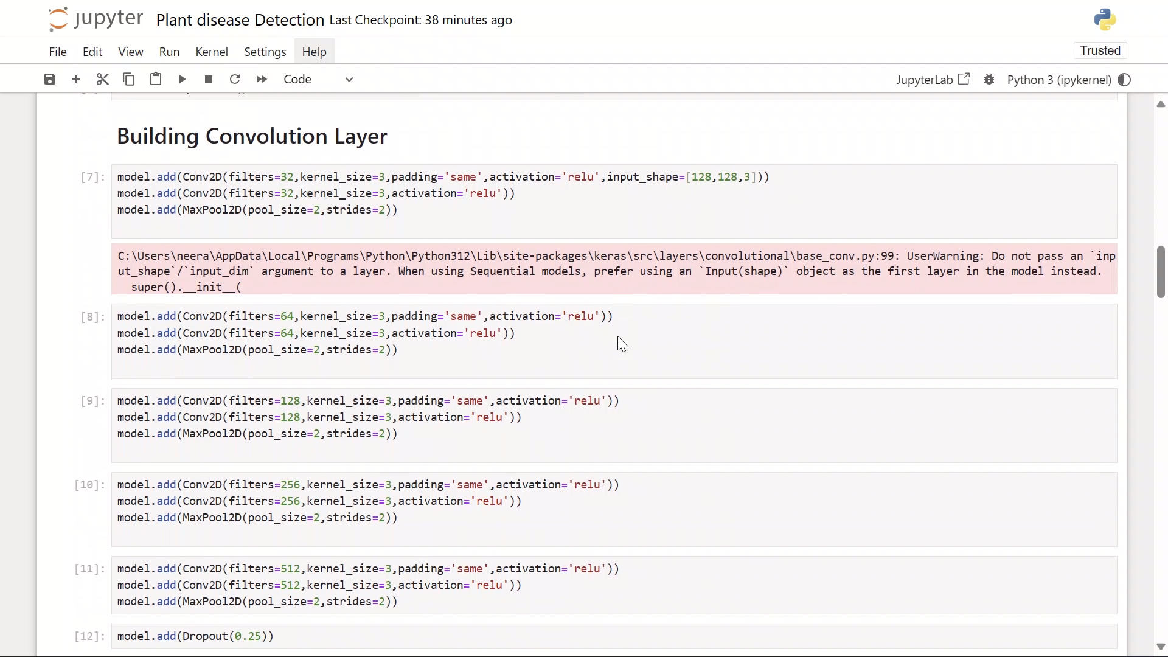
6)Project Progress/Implementation
First, we initiate the project by importing essential libraries to facilitate the subsequent stages of development. Subsequently, meticulous attention is directed towards the design and configuration of attributes essential for image preprocessing and training.
Following this preparatory phase, the model undergoes comprehensive training utilizing the designated datasets. Post-training, rigorous validation procedures ensue, wherein the model's efficacy and generalization capabilities are meticulously assessed through dedicated validation sets.
This systematic approach ensures the robustness and reliability of the developed model, thereby laying a solid foundation for its subsequent deployment and real-world application.
Following successful validation of the model, we proceed to augment its convolutional layers to enhance its capacity for feature extraction and pattern recognition.
In this augmentation process, meticulous attention is paid to the configuration of each layer to ensure progressive enhancement of the model's discriminative capabilities. Specifically, we adopt a stratified approach wherein each subsequent convolutional layer is strategically designed to discern increasingly complex features from the input data.
Beginning with the initial layer, which focuses on identifying basic shapes and textures, we progressively expand the filter size across subsequent layers to accommodate the extraction of more intricate and nuanced features. For instance, the filter size in the first layer is set to 64, followed by increments to 128, 256, and culminating at 512 in the subsequent layers. This hierarchical expansion of filter sizes empowers the model to discern finer details and nuances within the input data, thereby enriching its ability to accurately classify and characterize diverse instances of plant diseases.

Slide 12
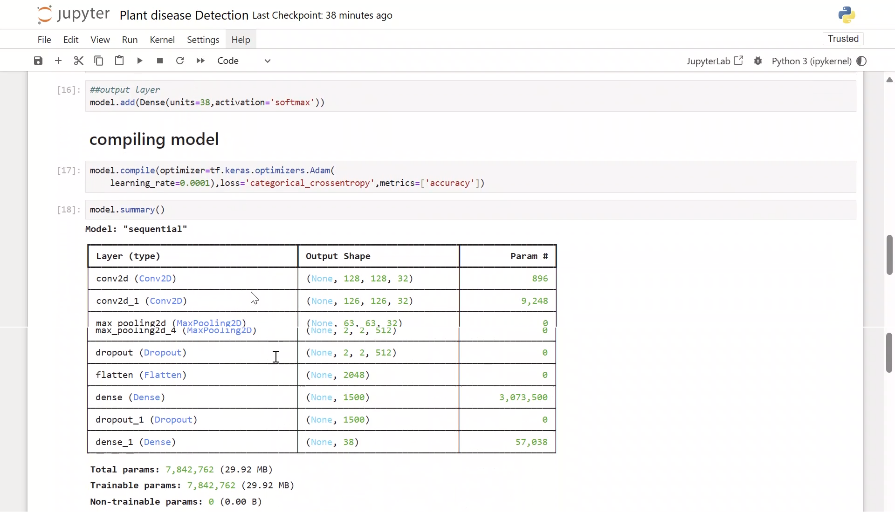
6)Project Progress/Implementation
Following the convolutional layer augmentation, a strategic approach is adopted to enhance the model's efficiency and generalization capacity.
Subsequently, a dropout layer is introduced, strategically dropping 25% of the data to mitigate overfitting and promote robustness in the model's performance.
Following this regularization step, the data is flattened to prepare it for further processing. Upon completion of these preparatory steps, the model undergoes compilation, wherein various hyperparameters and optimization strategies are configured to optimize its training process.
Upon successful compilation, a summary of the model is generated, providing insightful metrics including the volume of data processed, the number of trainable parameters, and non-trainable parameters.
This comprehensive overview serves as a crucial diagnostic tool, offering valuable insights into the model's architecture and computational requirements, thereby facilitating informed decision-making throughout the subsequent stages of development and deployment.

Slide 13
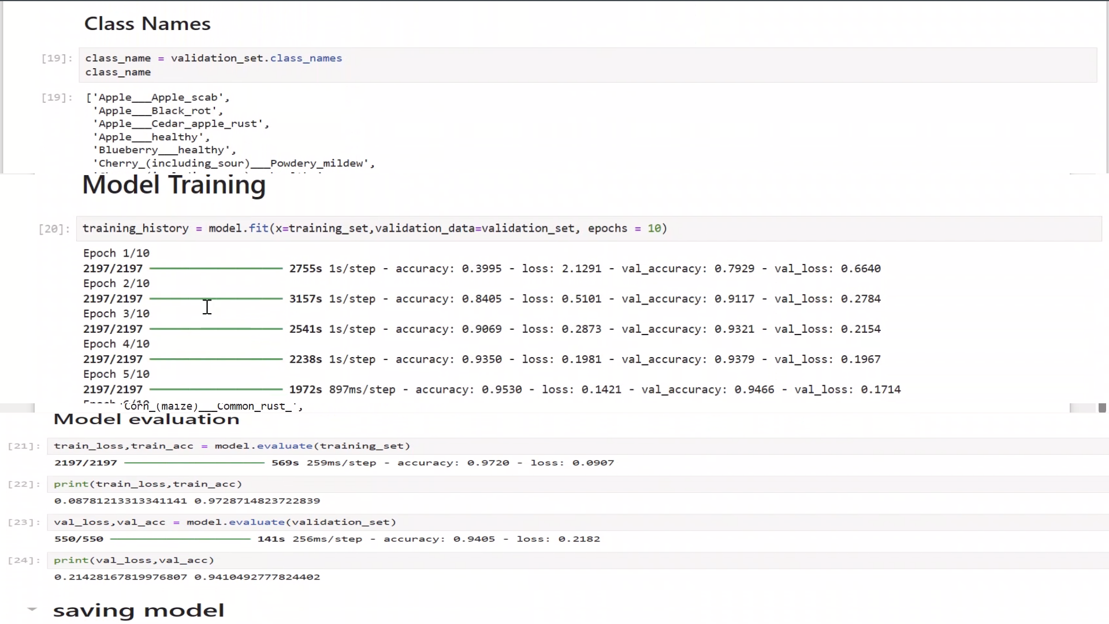
6)Project Progress/Implementation
Following successful compilation, the model is equipped with the capability to detect a diverse range of plant diseases, encompassing a multitude of classes such as "Apple_Apple_Scab" or "Grape_Black_Rot," alongside various others.
Each class represents a distinct disease or ailment that the model has been trained to identify with an impressive accuracy ranging between 90 to 95 percent. Subsequently, the model undergoes rigorous training for a predetermined number of epochs, typically set to 10 iterations.
Throughout this training process, the model refines its parameters and fine-tunes its predictive capabilities, leveraging the annotated dataset to iteratively enhance its performance.
Upon the completion of the training regimen, the trained model is saved, preserving its learned parameters and architecture for future deployment and utilization in real-world scenarios.
This culmination of training and preservation marks a significant milestone in the project's progression, paving the way for subsequent phases of validation, testing, and deployment with heightened efficacy and reliability.

Slide 14
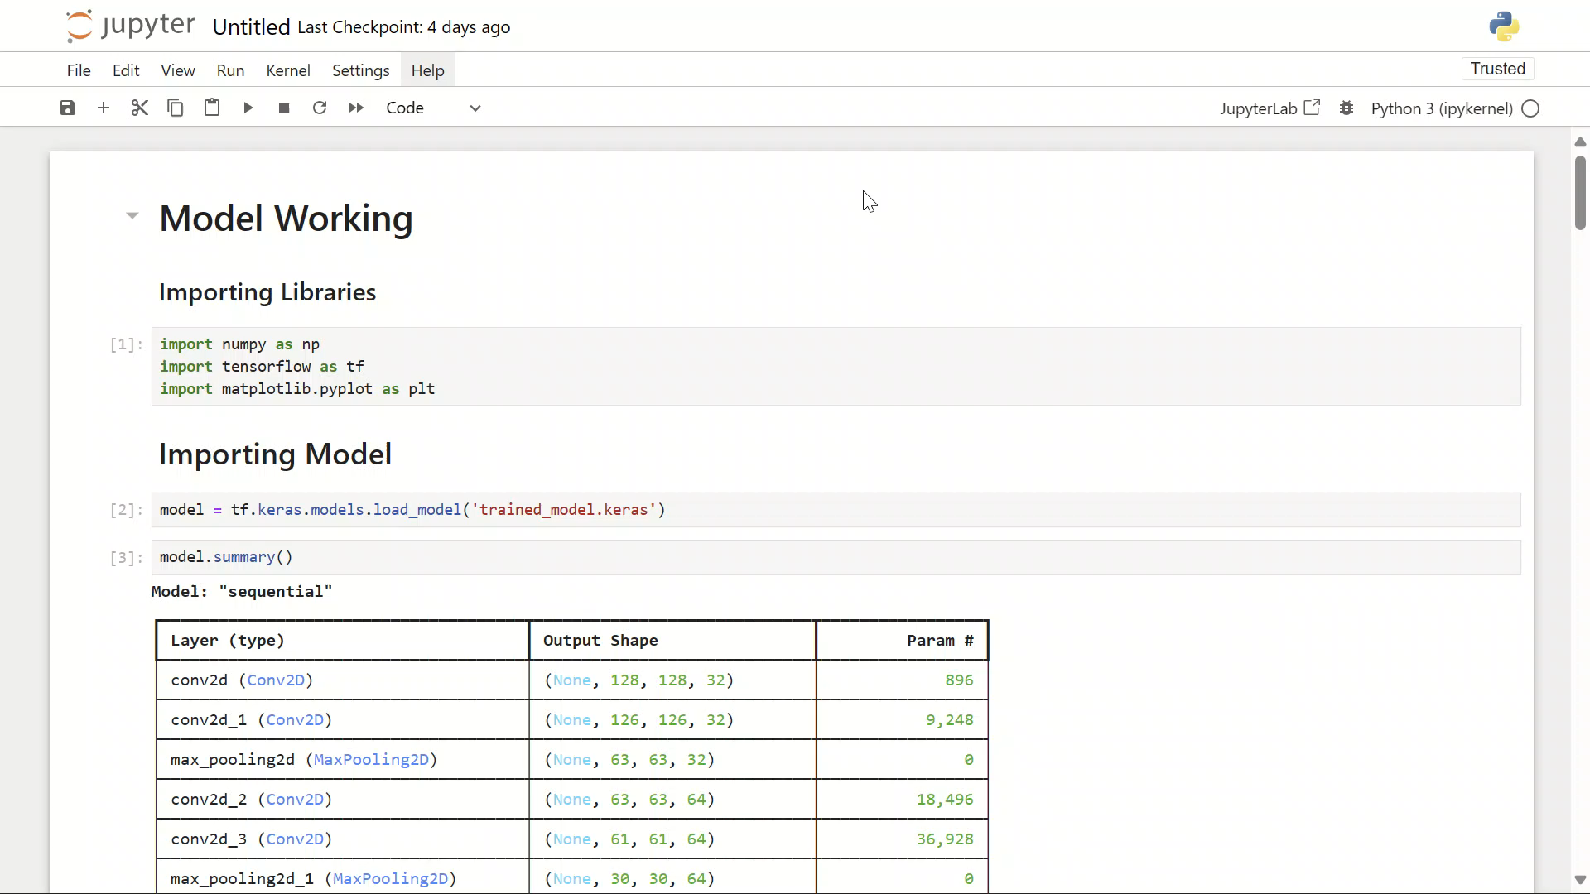
6)Project Progress/Implementation
Sharing a video showcasing the comprehensive workflow of the model, adhering to the outlined steps, adds a dynamic dimension to the project's documentation.

Slide 15
6)Project Progress/Implementation
Website Designing and UI
In our project, we integrated Streamlit to seamlessly connect our model with a user-friendly website interface. Streamlit provided us with a powerful framework for building interactive web applications with minimal effort.
By leveraging Streamlit's intuitive features and functionality, we were able to create a polished user interface that allows users to easily interact with our model.
Through the website, users can input images or data, trigger model predictions, and visualize results in real-time. Streamlit's flexibility and ease of use enabled us to quickly deploy our model and make it accessible to a wider audience, ultimately enhancing the usability and accessibility of our project.

Slide 16
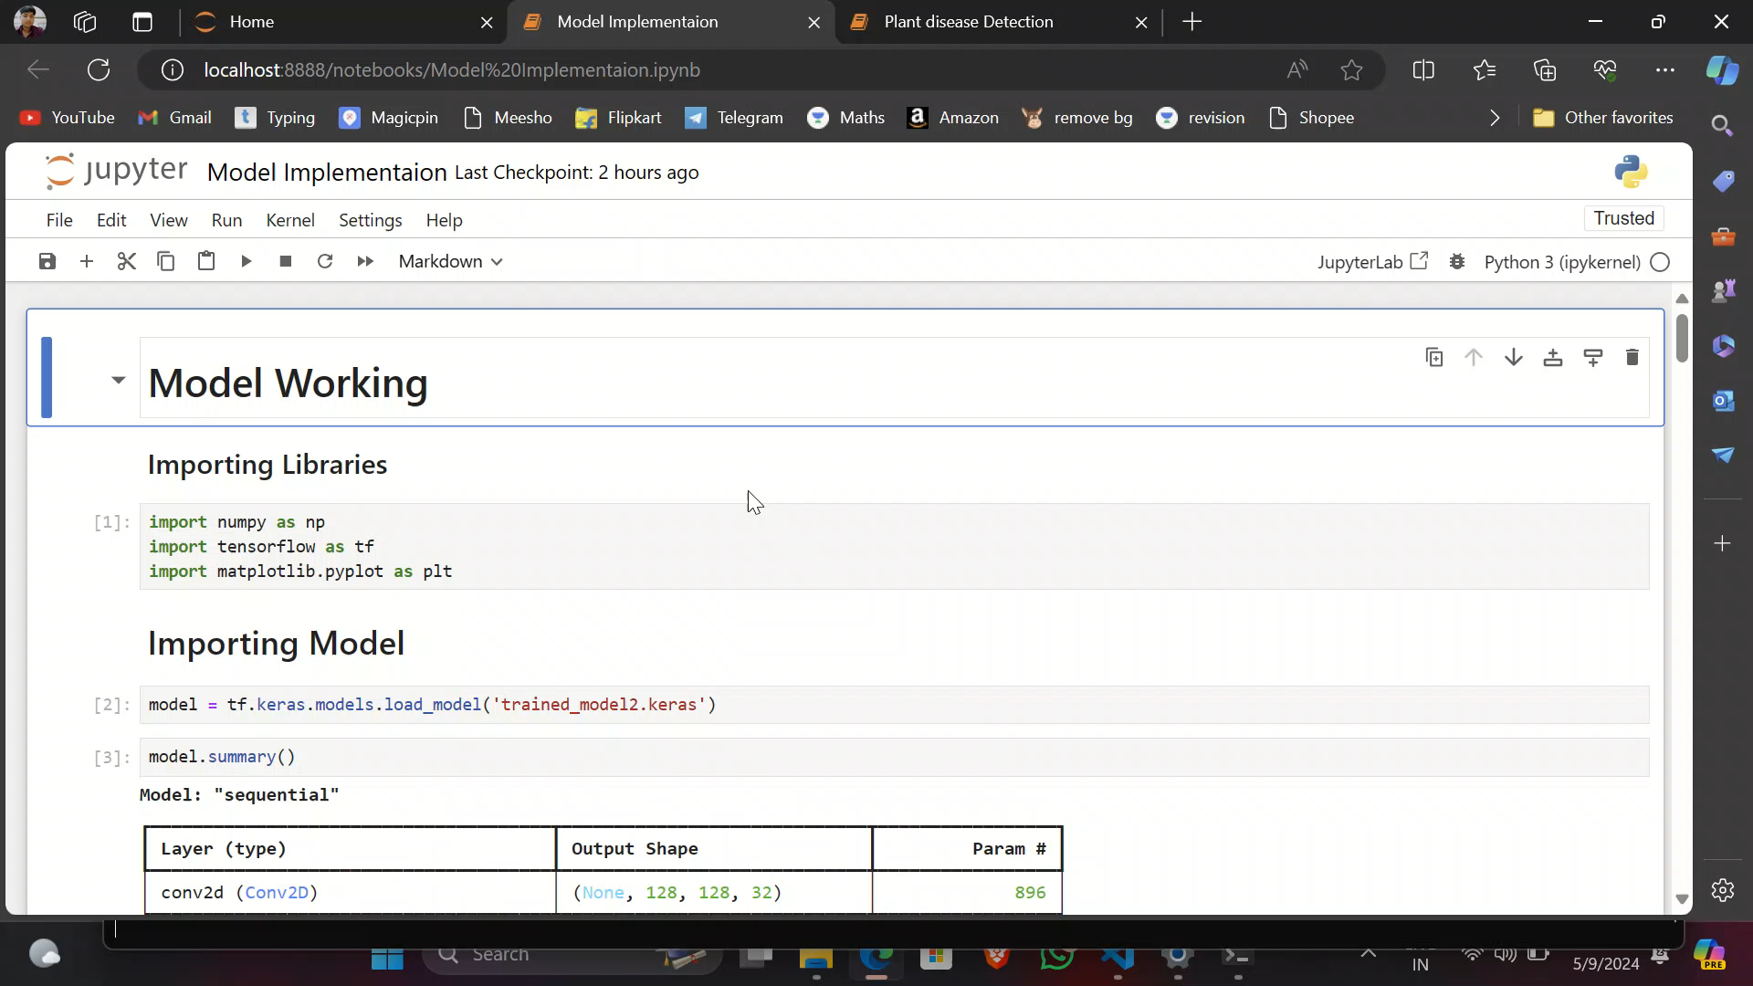
6)Project Progress/Implementation

Slide 17
6)Project Progress/Implementation
After completing the model training phase, our next step was to design a user-friendly website interface for seamless interaction with the model.
Leveraging Streamlit, a powerful web application framework, we successfully connected our trained model to the website. Streamlit provided us with a straightforward platform to create an intuitive and efficient user experience.
By integrating the model with Streamlit, users can easily input data, trigger model predictions, and visualize results directly from the website. This integration streamlines the implementation process and enhances accessibility, making it easier for users to interact with the model and obtain valuable insights.

Slide 18
8)References
Chen, J., Chen, J., Zhang, D., Sun, Y., & Nanehkaran, Y. A. (2020). Using deep transfer learning for image-based plant disease identification. Computers and electronics in agriculture, 173, 105393.
Ramcharan, A., Baranowski, K., & Ahmed, B. (2017). Deep learning for image-based cassava disease detection. Frontiers in plant science, 8, 293051.
Singh, J., & Kaur, H. (2019). Plant disease detection based on region-based segmentation and KNN classifier. In Proceedings of the International Conference on ISMAC in Computational Vision and Bio-Engineering 2018 (ISMAC-CVB) (pp. 1667-1675). Springer International Publishing.
Munisami, T., Ramsurn, M., Kishnah, S., & Pudaruth, S. (2015). Plant leaf recognition using shape features and colour histogram with K-nearest neighbour classifiers. Procedia Computer Science, 58, 740-747.
Pujari, D., Yakkundimath, R., & Byadgi, A. S. (2016). SVM and ANN based classification of plant diseases using feature reduction technique. IJIMAI, 3(7), 6-14.

Slide 19
8)References
Dataset references: https://www.kaggle.com/competitions/plant-pathology-2020-fgvc7/data

Slide 20
Thankyou

